Slide 1
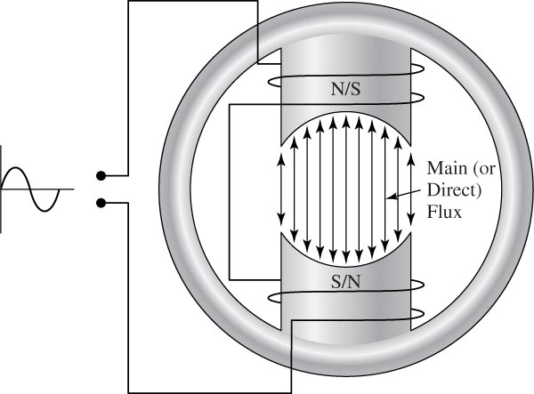
Other Electric Machines
Single-phase Induction Motor
Single-phase motors are used mostly to operate home appliances such as air conditioners, refrigerators, pumps, and fans.
Unlike polyphase induction motors, the stator field in the single-phase motor does not rotate. Instead it simply alternates polarity between poles as the ac voltage changes polarity.

Slide 2
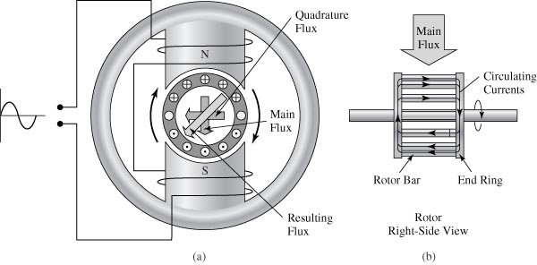
Other Electric Machines
Single-phase Induction Motor
Unlike polyphase induction motors, the stator field in the single-phase motor does not rotate. Instead it simply alternates polarity between poles as the ac voltage changes polarity.

Slide 3
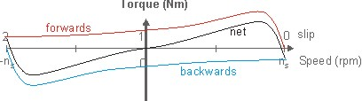
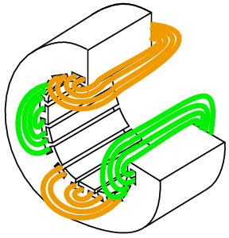
Other Electric Machines
Single-phase Induction Motor

Slide 4
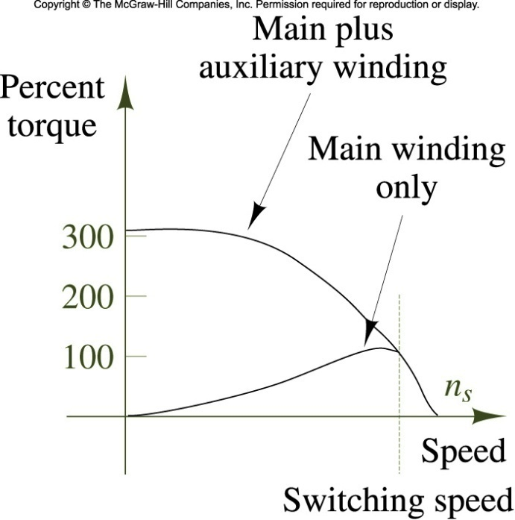
Other Electric Machines
Single-phase Induction Motor
Starting
There are several types of single-phase induction motors in use today. Basically they are identical except for the means of starting. They may be classified as: Split-phase motors; and capacitor-start motors

Slide 5
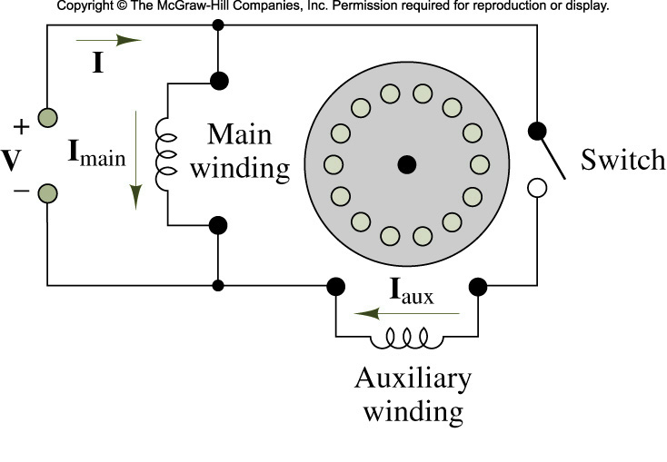
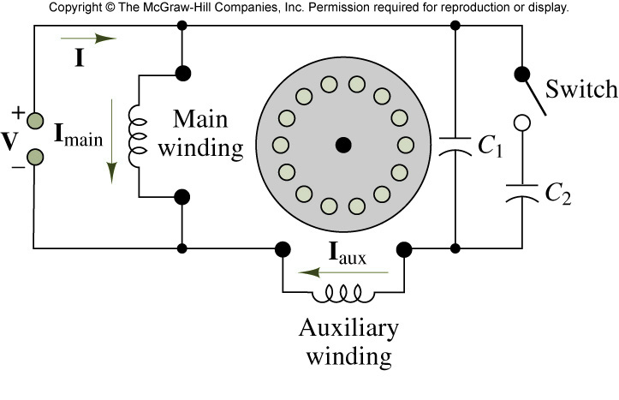
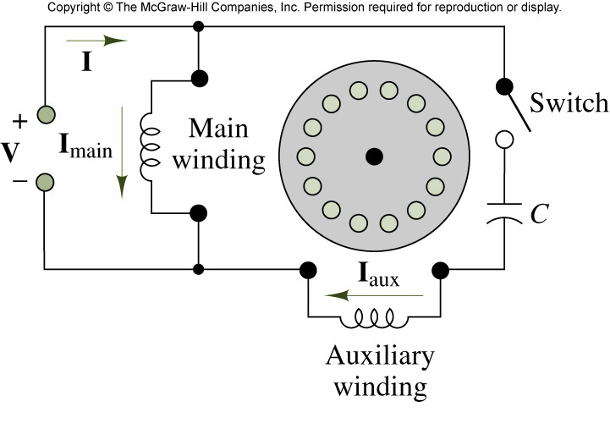
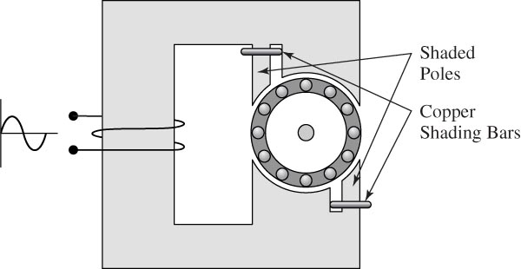
Other Electric Machines
Single-phase Induction Motor
Starting

Slide 6
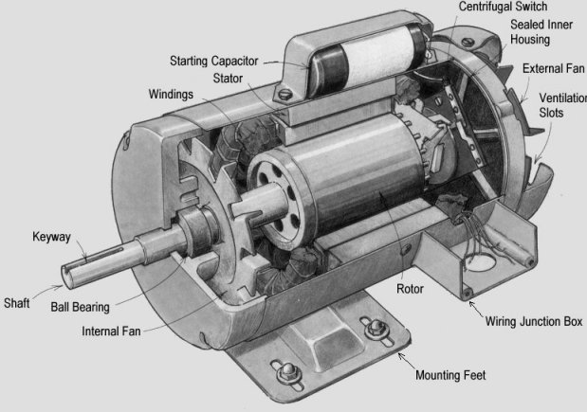
Other Electric Machines
Single-phase Induction Motor

Slide 7
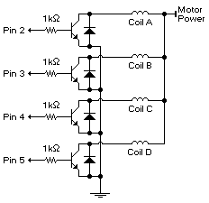
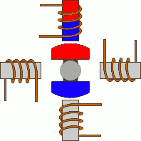

Other Electric Machines
Stepper Motor
A stepper motor is a brushless, synchronous electric motor that converts digital pulses into mechanical shaft rotation. Stepper motors are widely used today in printers, scanners, copy machine, small toys, Robots.

Slide 8
Other Electric Machines
Stepper Motor
Wave drive or Single-Coil Excitation
Only one coil is energized each time. This method is rarely used, generally when power saving is necessary. It provides less than half of the nominal torque of the motor, therefore the motor load cannot be high.

Slide 9
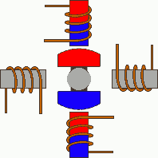
Other Electric Machines
Stepper Motor
Full step drive
The most often used method, is the Full step drive. The coils are energized in pairs. According to the connection of the coils (series or parallel) the motor will require double the voltage or double the current to operate that needs when driving with Single-Coil Excitation.

Slide 10
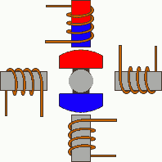
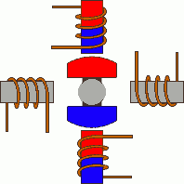
Other Electric Machines
Stepper Motor
Half stepping
This is a very interesting way to achieve double the accuracy of a positioning system. All coil pairs can be energized simultaneously, causing the rotor to rotate half the way as a normal step. This method can be single-coil or two-coil excitation as well.
Single-Coil excitation
Two-Coil excitation

Slide 11
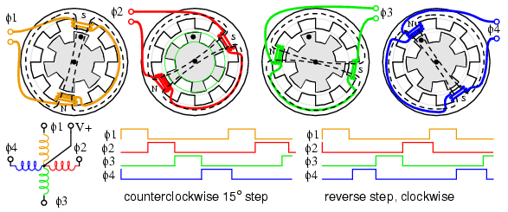
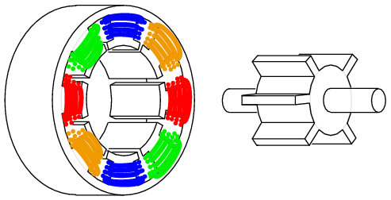
Other Electric Machines
Stepper Motor
Variable reluctance stepper motors

Slide 12
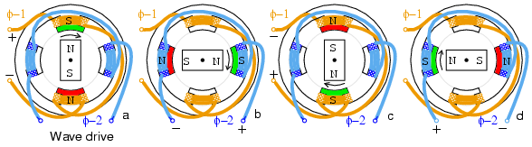
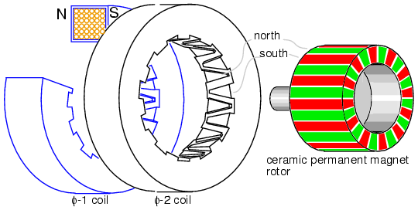
Other Electric Machines
Stepper Motor
Permanent magnet stepper motors

Slide 13
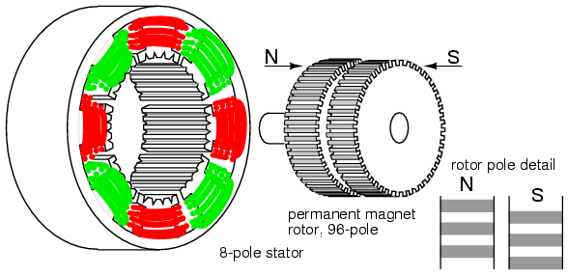
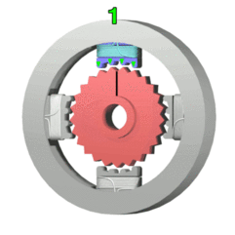
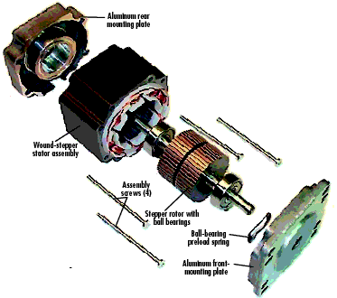
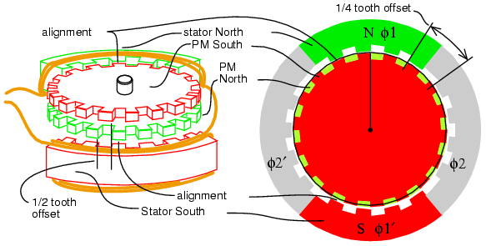
Other Electric Machines
Hybrid stepper motors

Slide 14
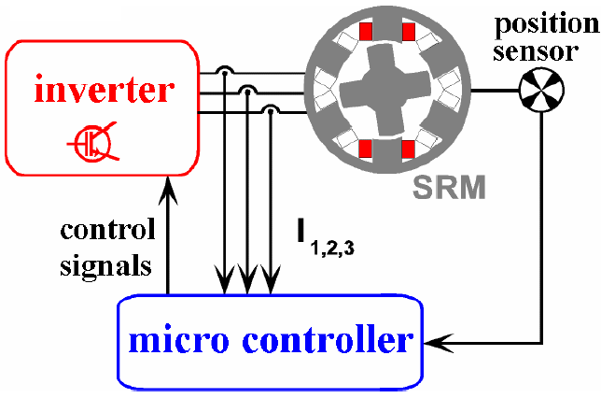
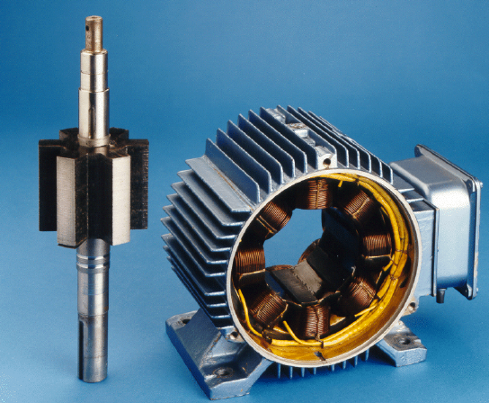
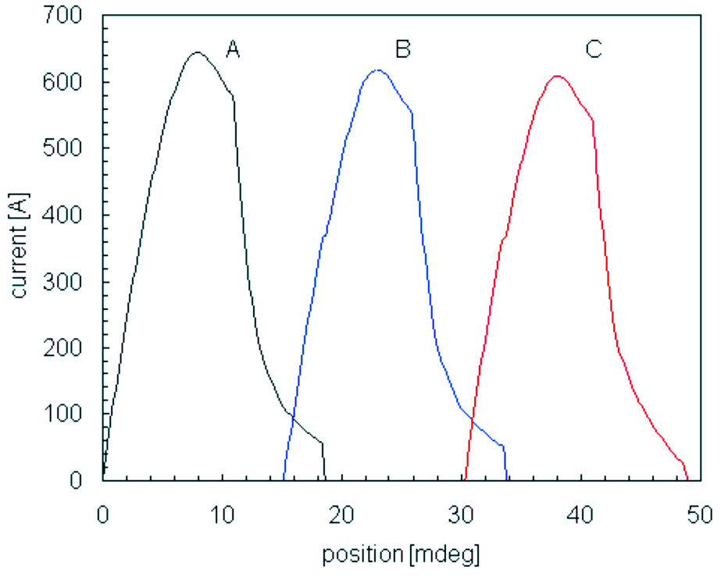
Other Electric Machines
Switched Reluctance Machine (SRM)

Slide 15
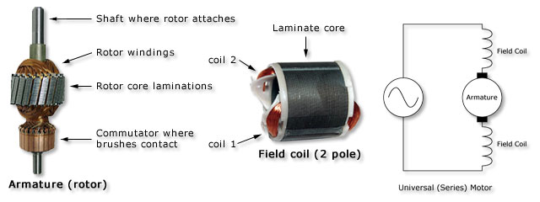
Other Electric Machines
Universal Motors

Slide 16
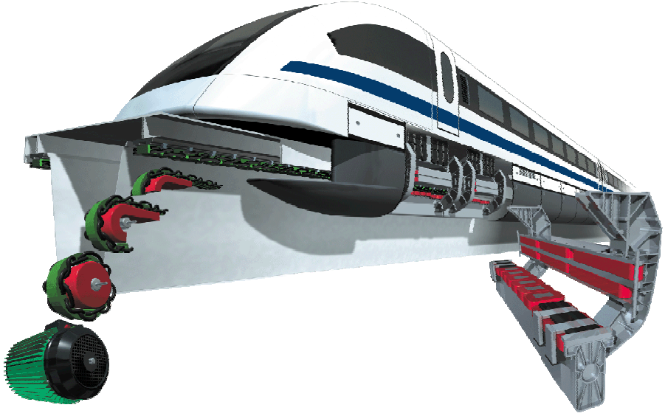
Other Electric Machines
Linear Motors

Slide 17
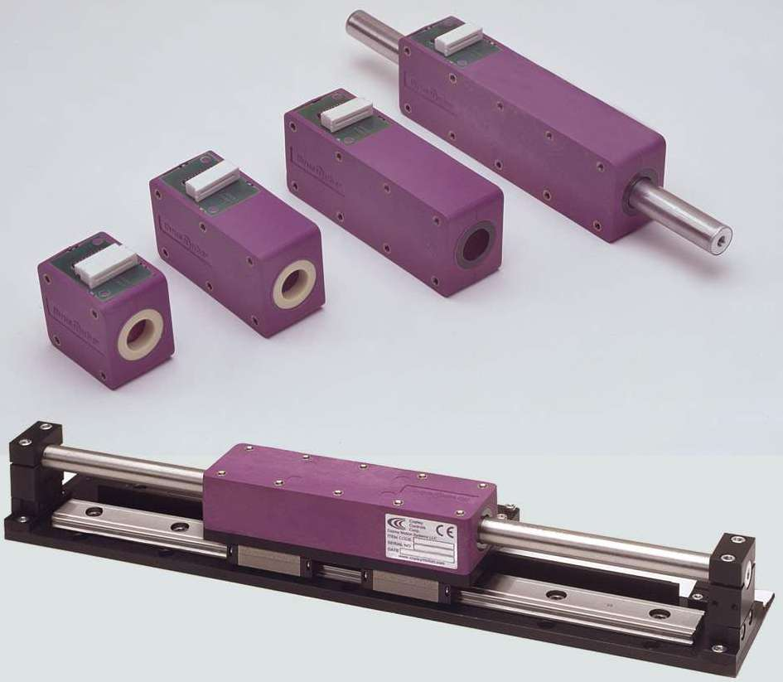
Other Electric Machines
Linear Motors

